Slide 1
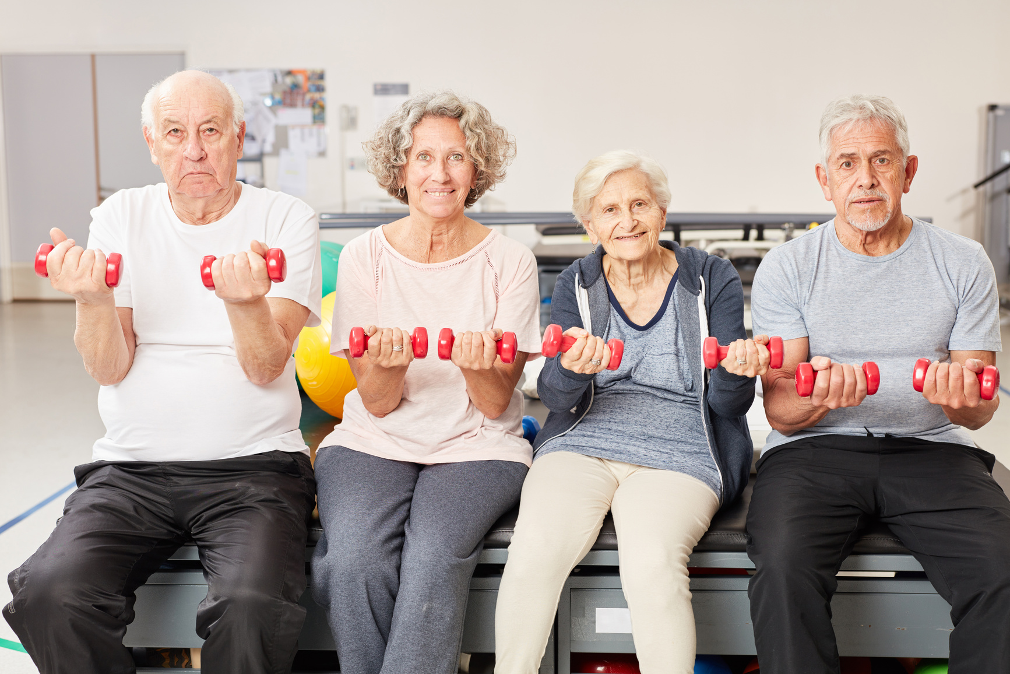


Strong Bones, Strong You
Stay active and keep your bones protected with regular strength training!
FallsFreeWI.org

Slide 2
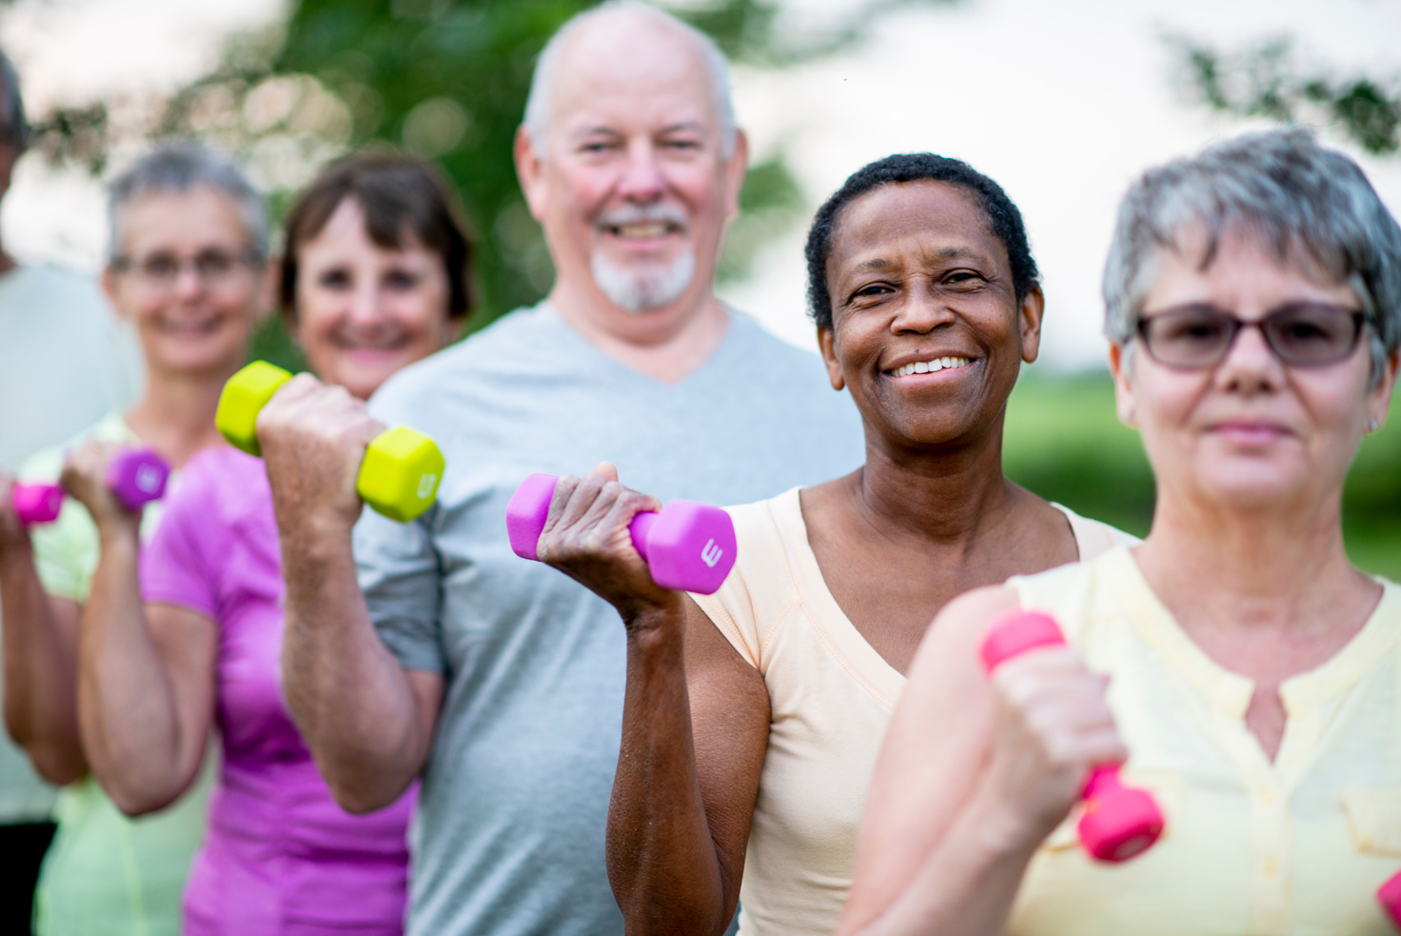

Keep Your Bones Happy & Healthy!
  Stay active
  Get enough calcium and vitamin D
  Avoid smoking and limit alcohol
FallsFreeWI.org

Slide 3
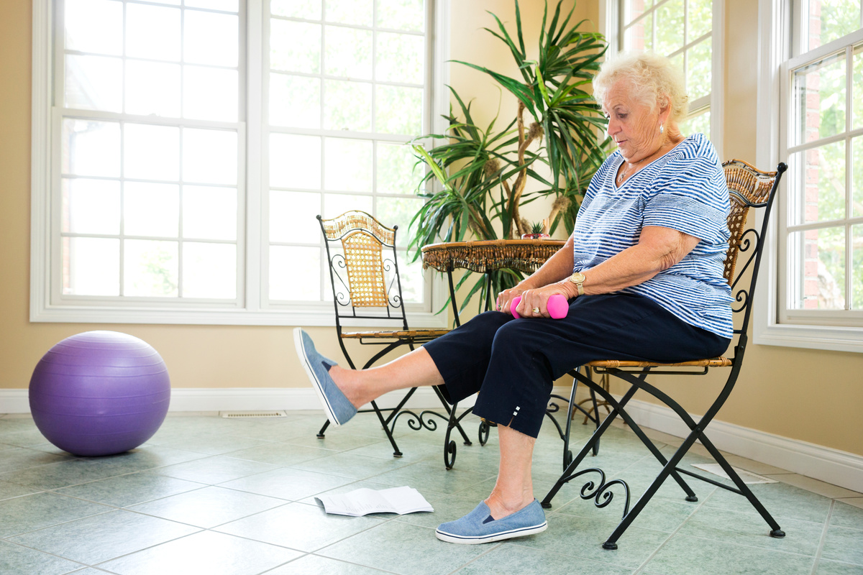
Prevent Falls and Fractures!
  Stay active
  Get enough calcium and vitamin D
  Make your home safer
  Avoid smoking and limit alcohol
  Care for your vision
  Choose comfortable shoes with good support
FallsFreeWI.org

